Slide 1
Bank System Programming
莊偉真

Slide 2
Contents
The Code and how it works

Slide 3
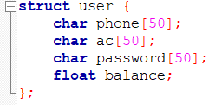
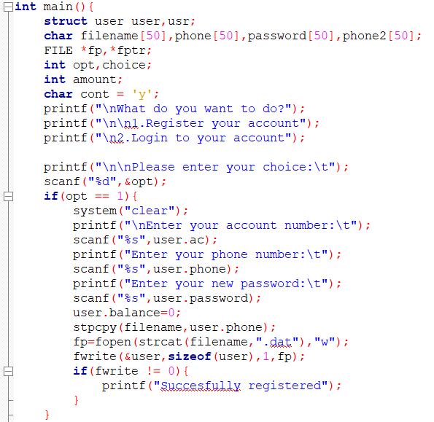
The Code
Then we ask the user whether they already have an account or not. If they choose to open an account they will have to enter their a new account number, their phone number, and password then we store those data to user array.
First we create the array to save store the user data

Slide 4
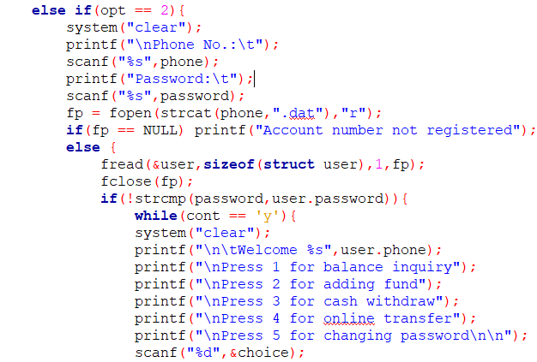
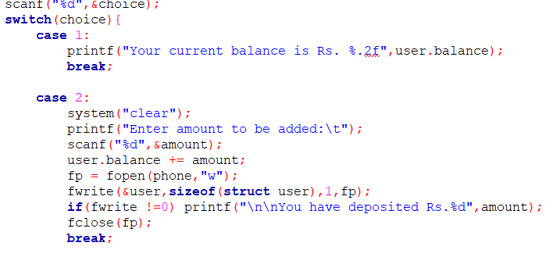
We will be using case for each option that the user chooses
After that the user can login using the phone number and password they registered with. If they entered the wrong data they will have to login again. After they successfully login they will be directed to the menu where they can choose what they want to do.

Slide 5

And after the user is done with the action we will ask them whether they still want to use the online banking system or not

